Slide 1

Object Oriented Programming-I
CS-322
Inheritance in C++
August 2020
Instructor: Bilal Jan

Slide 2

Outlines
The need of re-use in OOP
Inheritance
Access Specifiers and inheritance
Inheritance types
Diamond Problem
Base and derived class relationship: use case constructors and destructors
Wrap-up
Example programs

Slide 3

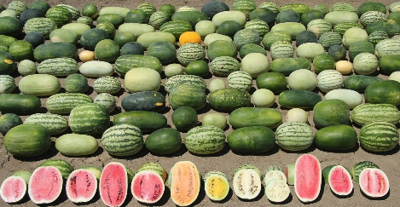
Genetic Inheritance
https://www.tes.com/lessons/Y9kfi0M1v-KTJg/science-inherited-traits-in-humans-and-animals
The seven species of watermelon have an incredible amount of diversity. Credit: Xingping Zhang/Syngenta

Slide 4
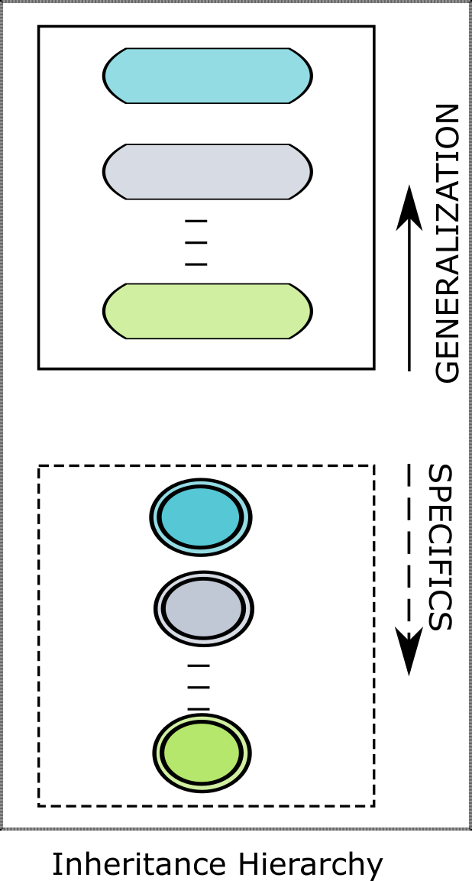
Generics vs Specifics
New classes are created from existing classes
Absorb the attributes and behaviors of parents
Add new features in child classes
The new classes are called Derived Class.
These derived class inherits data members and member functions from a previously defined base class(es).

Slide 5
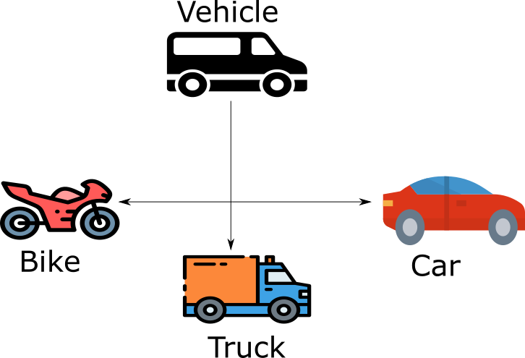
Example
Vehicle as base class with derived (children) classes
Car
Bike
Truck

Slide 6
Inheritance and its types
Single Inheritance
Class inherits from one base class
Multiple Inheritance
Class inherits from multiple base classes
Three types of inheritance:
public: Derived objects are accessible by the base class objects (focus of this chapter)
private: Derived objects are inaccessible by the base class
protected: Derived classes and friends can access protected members of the base class

Slide 7
Some more examples

Slide 8
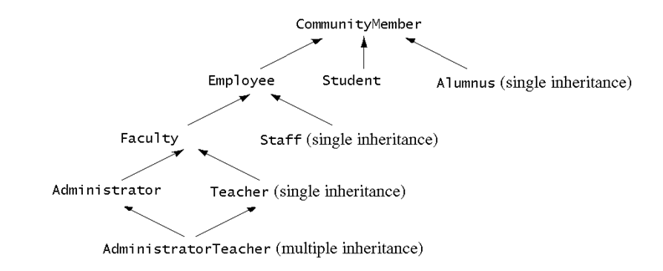
Inheritance hierarchy
Inheritance hierarchy for University CommunityMember (Chap11 of Ref-book)

Slide 9
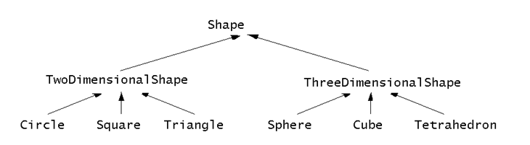
Inheritance hierarchy
Inheritance hierarchy for Shape class (Chap11 of Ref-book)

Slide 10
Syntax of Inheritance
class A{
private:
data-members;
public:
member-functions;
};
class B : <access-specifier> A
{
private:
data-members-B;
public:
member-functions-B;
};
private
public protected

Slide 11
Example Vehicle class
#include <iostream>
using namespace std;
class Vehicle{
private:
string brand;
double mlg;
double availableFuel;
public:
void create(string b,double m,double fuel){
brand=b;
mlg=m;
availableFuel=fuel;
}
void drive(double distance){
if(distance/mlg<=availableFuel){
cout<<"Drived for "<<distance<<" kilo meters"<<endl;
availableFuel=availableFuel-distance/mlg;
cout<<"Available Fuel "<<availableFuel<<endl;
}
else
cout<<"Limited Fuel>>>drive not possible->refill needed"<<endl;
}
void honk(){
cout<<"the horn sound of any vehicle type"<<endl;
}
};

Slide 12
Example Truck & Car derived classes
class Truck:public Vehicle{
private:
int noWheels;
public:
void honk(){
cout<<"Pawonnn Pawonnn"<<endl;
//my own onomatopoeia for a traditional truck
}
};
class Car:public Vehicle{
private:
string color;
public:
void honk(){
cout<<"Peep Peep"<<endl;
}
};

Slide 13
Testing the inheritance
int main() {
cout << "Creating vehicle types" << endl;
Truck truck;
Car car;
truck.create("Hino", 6.7, 100);
truck.honk();
truck.drive(50);
car.create("Toyota Corolla", 18.1, 20);
car.honk();
car.drive(200);
return 0;
}
OUTPUT
Creating vehicle types
Pawonnn Pawonnn
Drived for 50 kilo meters
Available Fuel 92.5373
Peep Peep
Drived for 200 kilo meters
Available Fuel 8.95028

Slide 14
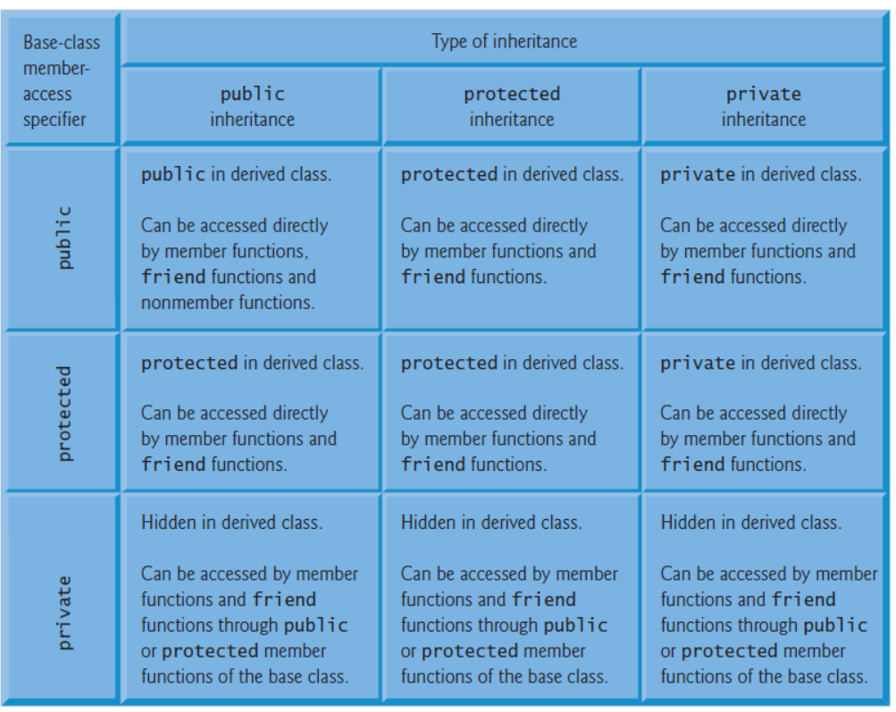
Scope of accessibility
Chap 11, ref-book

Slide 15
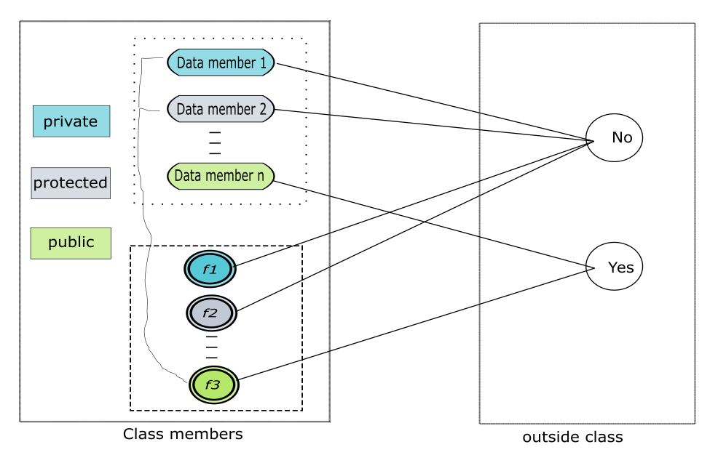
Scope of accessibility
No inheritance

Slide 16
Scope of accessibility
#include <iostream>
using namespace std;
class A{
private:
int privateMember;
void setprivate(int v){
cout<<"setprivate() called "<<endl;
privateMember=v;
}
void showprivate(){
cout<<"showprivate() value of member is "<<privateMember<<endl;
}
protected:
int protectedMember;
void setprotected(int v){
cout<<"setproctected() called "<<endl;
protectedMember=v;
}
void showprotected(){
cout<<"showprotected() value of member is "<<protectedMember<<endl;
}
public:
int publicMember;
void setpublic(int v){
cout<<"setpublic called "<<endl;
publicMember=v;
}
void showpublic(){
cout<<"showpublic() value of member is "<<publicMember<<endl;
}
void setAll(int s){
setprivate(s);
setprotected(s+1);
}
void showAll(){
showprivate();
showprotected();
}
};

Slide 17
Scope of accessibility
int main() {
//private and protected members of A are not accessible directly through object
//accessible however through public members only through object
A objA;
objA.publicMember=100;
objA.showpublic();
objA.setAll(10);
objA.showAll();
return 0;
}
OUTPUT
showpublic() value of member is 100
setprivate() called
setproctected() called
showprivate() value of member is 10
showprotected() value of member is 11

Slide 18
Scope of accessibility Protected Members
protected inheritance
Intermediate level of protection between public and private inheritance
Derived-class members can refer to public and protected members of the base class simply by using the member names
Bad point is that protected data “breaks” encapsulation

Slide 19
Scope of accessibility Protected Members
Object of a derived class
Can be treated as an object of the base class
Reverse not true - base class objects not a derived-class object
Downcasting a pointer
Use an explicit cast to convert a base-class pointer to a derived-class pointer
Be sure that the type of the pointer matches the type of object to which the pointer points
derivedPtr = static_cast< DerivedClass * > basePtr;

Slide 20
Using Member Functions
Derived class
Cannot directly access private members of its base class
“the derived class object cannot directly access the private (data) members of the base class. The same is true for the member functions of a derived class. That is, the member functions of a derived class cannot directly access the private members of the base class”. (pg734,ref2)
Hiding private members is a huge help in testing, debugging and correctly modifying systems.

Slide 21
19.6 Overriding Base-Class Members in a Derived Class
To override a base-class member function
In derived class, supply new version of that function
Same function name, different definition
The scope-resolution operator may be used to access the base class version from the derived class
baseClass :: function()

Slide 22
Direct and Indirect Base Classes
Direct base class
Explicitly listed derived class’ header with the colon (:) notation when that derived class is declared.
class HourlyWorker : public Employee
Employee is a direct base class of HourlyWorker
Indirect base class
Inherited from two or more levels up the class hierarchy
class MinuteWorker : public HourlyWorker
Employee is an indirect base class of MinuteWorker

Slide 23
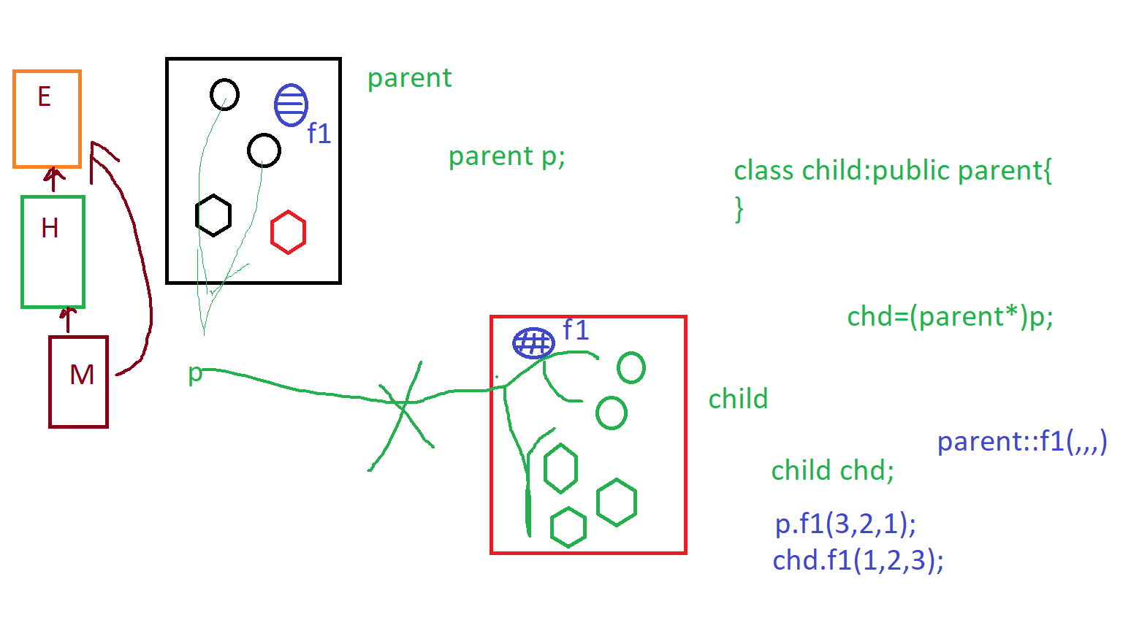
Direct and Indirect Base Classes

Slide 24
Using Constructors and Destructors in Derived Classes
Base class initializer
Uses member-initializer syntax
Can be provided in the derived class constructor to call the base-class constructor explicitly
Otherwise base class’ default constructor called implicitly
Base-class constructors and base-class assignment operators are not inherited by derived classes
However, derived-class constructors and assignment operators can call still them

Slide 25
Using Constructors and Destructors in Derived Classes
Derived-class constructor
Calls the constructor for its base class first to initialize its base-class members
If the derived-class constructor is omitted, its default constructor calls the base-class’ default constructor
Destructors are called in the reverse order of constructor calls.
Derived-class destructor is called before its base-class destructor

Slide 26
point.h
#ifndef POINT_H_
#define POINT_H_
class Point {
public:
Point( int = 0, int = 0 ); // default constructor
~Point(); // destructor
protected: // accessible by derived classes
int x, y; // x and y coordinates of Point
}; // end class Point

Slide 27
#include <iostream>
using namespace std;
#include "point.h"
// Constructor for class Point
Point::Point( int a, int b )
{
x = a;
y = b;
cout << "Point constructor: " << '[' << x << ", " << y << ']' << endl;
} // end Point constructor
// Destructor for class Point
Point::~Point()
{
cout << "Point destructor: "
<< '[' << x << ", " << y << ']' << endl;
} // end Point destructor
point.cpp

Slide 28
circle.h
#ifndef CIRCLE_H
#define CIRCLE_H
#include "point.h"
class Circle : public Point { //class Circle publicly inherited from Point
public:
// default constructor
Circle( double r = 0.0, int x = 0, int y = 0 );
~Circle();
private:
double radius;
}; // end class Circle
#endif

Slide 29
circle.cpp
#include <iostream>
using namespace std;
#include "circle.h"
// Constructor for Circle calls constructor for Point
Circle::Circle( double r, int a, int b )
: Point( a, b ) // call base-class constructor
{
radius = r; // should validate
cout << "Circle constructor: radius is "
<< radius << " [" << x << ", " << y << ']' << endl;
} // end Circle constructor
// Destructor for class Circle
Circle::~Circle()
{
cout << "Circle destructor: radius is "
<< radius << " [" << x << ", " << y << ']' << endl;
} // end Circle destructor

Slide 30
Test.cpp
#include <iostream>
using namespace std;
#include "point.h"
#include "circle.h"
int main()
{
// Show constructor and destructor calls for Point
{
Point p( 10, 14 );
} // end block
cout << endl;
Circle circle1( 2.5, 15, 27 );
cout << endl;
Circle circle2( 8, 6, 6 );
cout << endl; return 0;
} // end function main

Slide 31
OUTPUT
Point constructor: [10, 14]
Point destructor: [10, 14]
Point constructor: [15, 27]
Circle constructor: radius is 2.5 [15, 27]
Point constructor: [6, 6]
Circle constructor: radius is 8 [6, 6]
Circle destructor: radius is 8 [6, 6]
Point destructor: [6, 6]
Circle destructor: radius is 2.5 [15, 27]
Point destructor: [15, 27]

Slide 32
Implicit Derived-Class Object to Base-Class Object Conversion
baseClassObject = derivedClassObject;
This will work
Remember, the derived class object has more members than the base class object
Extra data is not given to the base class
derivedClassObject = baseClassObject;
May not work properly
Unless an assignment operator is overloaded in the derived class, data members exclusive to the derived class will be unassigned
Base class has less data members than the derived class
Some data members missing in the derived class object

Slide 33
Implicit Derived-Class Object to Base-Class Object Conversion
Four ways to mix base and derived class pointers and objects:
Referring to a base-class object with a base-class pointer
Allowed
Referring to a derived-class object with a derived-class pointer
Allowed
Referring to a derived-class object with a base-class pointer
Possible syntax error
Code can only refer to base-class members, or syntax error
Referring to a base-class object with a derived-class pointer
Syntax error
The derived-class pointer must first be cast to a base-class pointer

Slide 34
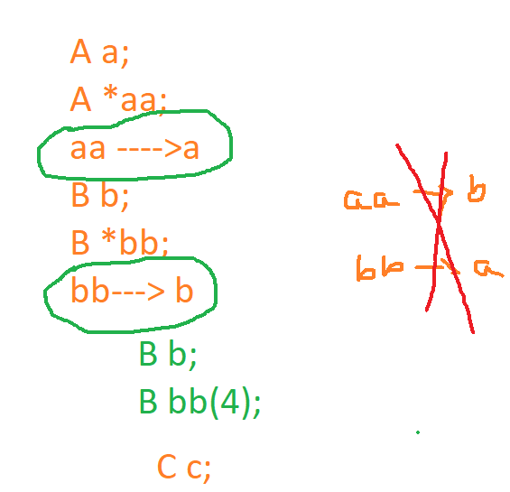
Implicit Derived-Class Object to Base-Class Object Conversion

Slide 35
Composition vs. Inheritance
"is a" relationship
Inheritance
"has a" relationship
Composition - class has an object from another class as a data member
Employee “is a” BirthDate; //Wrong!
Employee “has a” BirthDate;//Composition

Slide 36
Uses A And Knows A Relationships
“uses a” relationship
One object issues a function call to a member function of another object
“knows a” relationship
One object is aware of another
Contains a pointer handle or reference handle to another object
Also called an association

Slide 37
References
C++ How to Program by Dietel & Dietel, 9th Edition
C++ PROGRAMMING: FROM PROBLEM ANALYSIS TO PROGRAM DESIGN 5th Edition by D.S. MALIK

Slide 38
Coming Up NEXT
Friend-virtual functions with polymorphism

